Slide 1
VE215 Mid RC Part 4
Second-order circuits

Slide 2
Initial conditions
Why do we need initial conditions?
To determine that the solution to the differential equation exists and is unique.

Slide 3
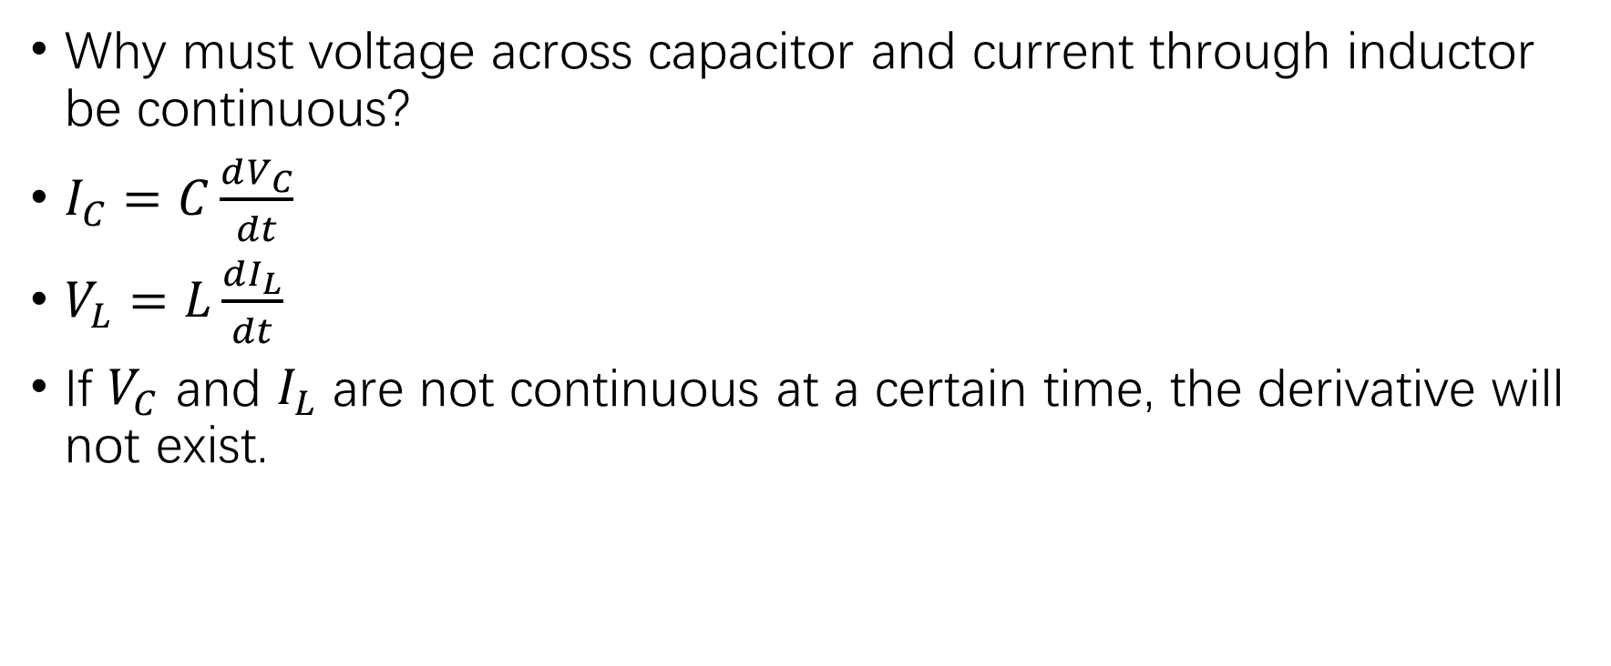
Initial conditions
Why must voltage across capacitor and current through inductor be continuous?
$I_{C}=C\frac{dV_{C}}{dt}$
$V_{L}=L\frac{dI_{L}}{dt}$
If $V_{C}$ and $I_{L}$ are not continuous at a certain time, the derivative will not exist.

Slide 4

Example 8.2
Find $i_{L}(0^{+})$, $v_{C}(0^{+})$, $\frac{di_{L}}{dt}(0^{+})$, and $\frac{dv_{C}}{dt}(0^{+})$.

Slide 5

RLC circuit basic models
Source-free series with nonzero initial conditions
$\frac{d^{2}i}{{dt}^{2}}+\frac{R}{L}\frac{di}{dt}+\frac{1}{LC}i=0$
$i\left(0^{+}\right)=I_{0}$
$\frac{di}{dt}\left(0^{+}\right)=−\frac{1}{L}(I_{0}R+V_{0})$

Slide 6

RLC circuit basic models
Source-free parallel with nonzero initial conditions
$\frac{d^{2}v}{{dt}^{2}}+\frac{1}{RC}\frac{dv}{dt}+\frac{1}{LC}v=0$
$v\left(0^{+}\right)=V_{0}$
$\frac{dv}{dt}\left(0^{+}\right)=−\frac{1}{C}(\frac{V_{0}}{R}+I_{0})$

Slide 7
High-order homogeneous linear ODEs with constant coefficients
Coefficient comparison (what you must know)
Find eigen equation and solve for eigen roots
Find the general solution with undetermined coefficients
Apply the initial conditions to solve for coefficients
Unilateral Laplace transform (optional for VE215, but you will learn or should have learnt it from VV256 and VE216)

Slide 8
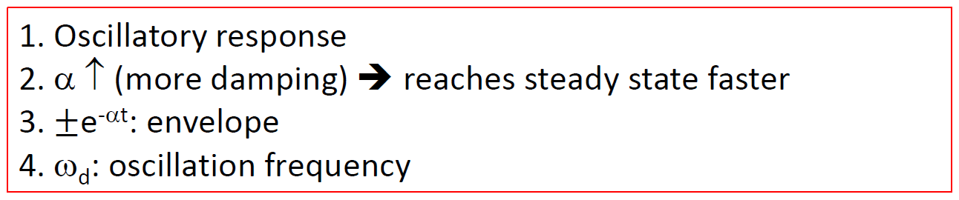



An error in the lecture slides
$i\left(t\right)=e^{−αt}(B_{1}cosω_{d}t+B_{2}sinω_{d}t)$
The envelopes should be $±e^{−αt}\sqrt{B_{1}^{2}+B_{2}^{2}}$.

Slide 9

RLC circuit basic models
Step input series at initial rest
$\frac{d^{2}v}{{dt}^{2}}+\frac{R}{L}\frac{dv}{dt}+\frac{1}{LC}v=\frac{1}{LC}V_{s}$
$v\left(0^{+}\right)=0$
$\frac{dv}{dt}\left(0^{+}\right)=0$

Slide 10

RLC circuit basic models
Step input parallel at initial rest
$\frac{d^{2}i}{{dt}^{2}}+\frac{1}{RC}\frac{di}{dt}+\frac{1}{LC}i=\frac{1}{LC}I_{s}$
$i\left(0^{+}\right)=0$
$\frac{di}{dt}\left(0^{+}\right)=0$

Slide 11
High-order inhomogeneous linear ODEs with constant coefficients
Coefficient comparison (what you must know)
Find eigen equation and solve for eigen roots
Find the general solution to the homogeneous ODE with undetermined coefficients
Find the particular solution and add it to the general solution above
Apply the initial conditions to solve for coefficients
Unilateral Laplace transform (optional)

Slide 12
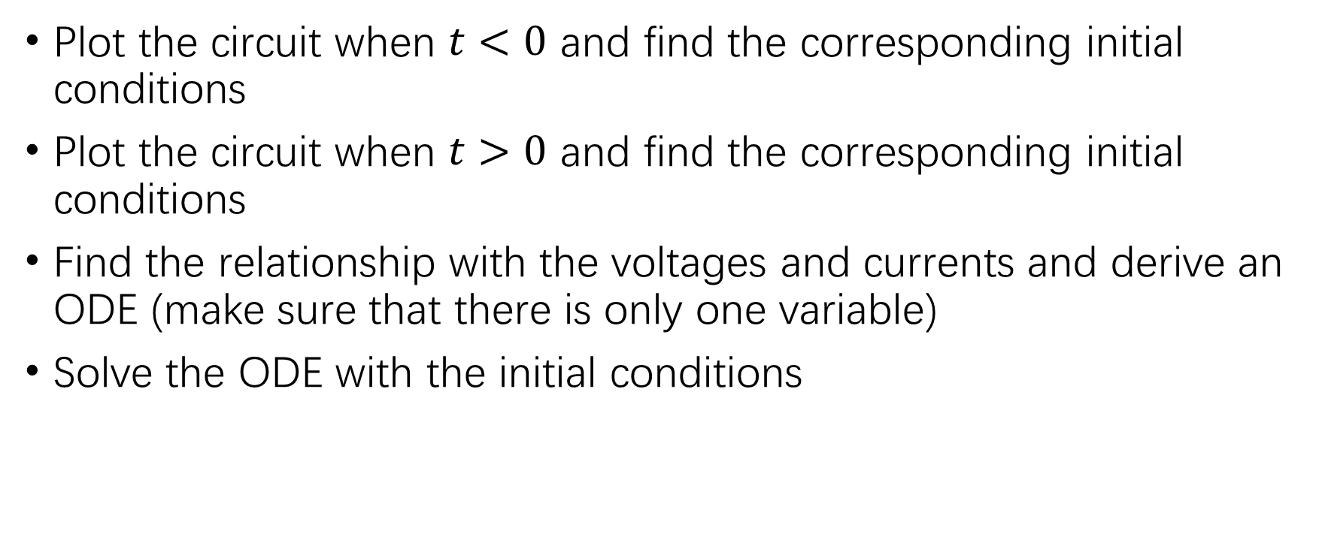
RLC circuit
Plot the circuit when $t<0$ and find the corresponding initial conditions
Plot the circuit when $t>0$ and find the corresponding initial conditions
Find the relationship with the voltages and currents and derive an ODE (make sure that there is only one variable)
Solve the ODE with the initial conditions

Slide 13
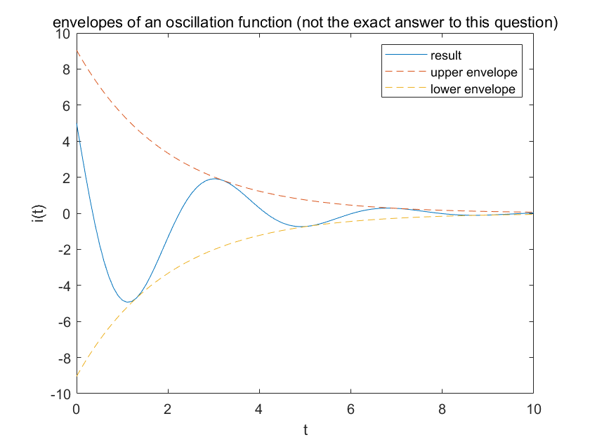

Practice problem 8.4
$\frac{d^{2}i}{{dt}^{2}}+5\frac{di}{dt}+9i=0$
Initial conditions: $i\left(0^{+}\right)=5$, $v\left(0^{+}\right)=0$, and $\frac{di}{dt}\left(0^{+}\right)=−25$.

Slide 14
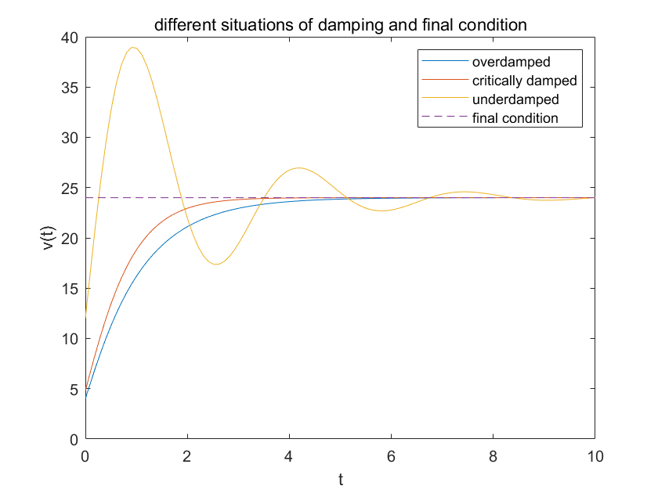

Example 8.7.(a)
$\frac{d^{2}v}{{dt}^{2}}+5\frac{dv}{dt}+4v=96$
Initial conditions: $i\left(0^{+}\right)=4$, $v\left(0^{+}\right)=4$, and $\frac{dv}{dt}\left(0^{+}\right)=16$.

Slide 15
Second-order linear ODEs with constant coefficients
Can you think of another system characterized by a second-order linear ODE with constant coefficients? (Mechanical oscillation in VP150.)
Underdamped: sinusoidal oscillation with decay
Critically damped: on the edge of oscillation and pure decay
Overdamped: pure decay
Final condition: characterized by the RHS (usually a constant in VE215)

Slide 16
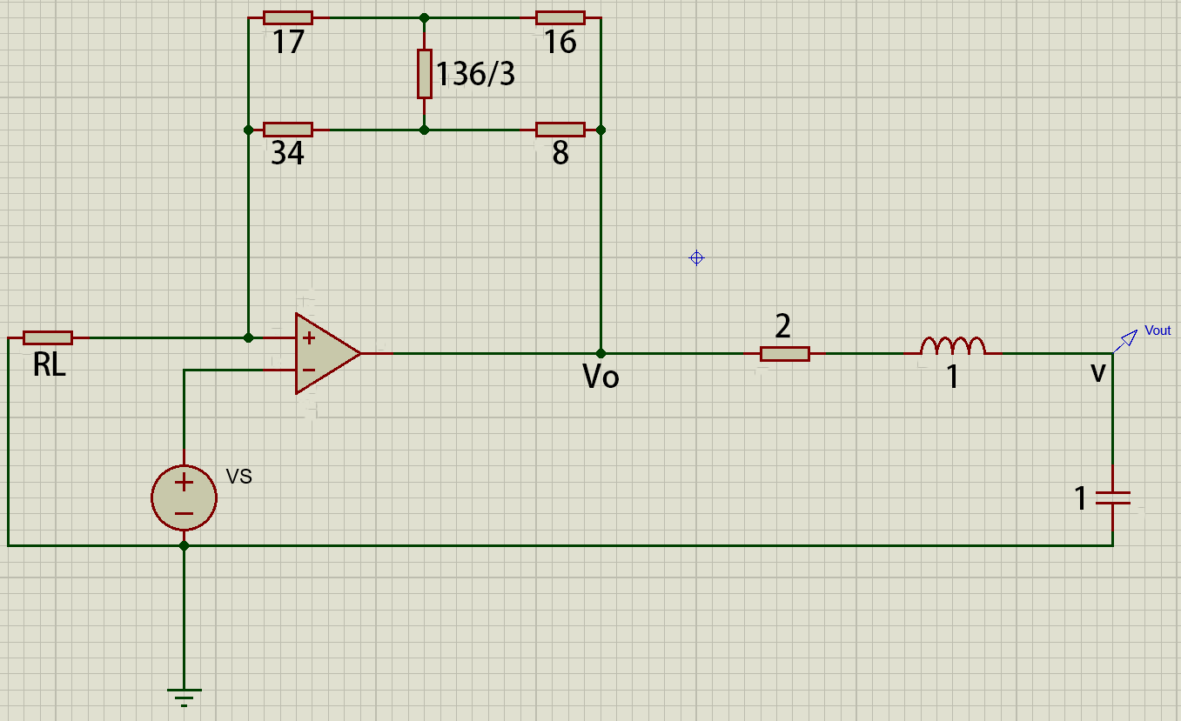
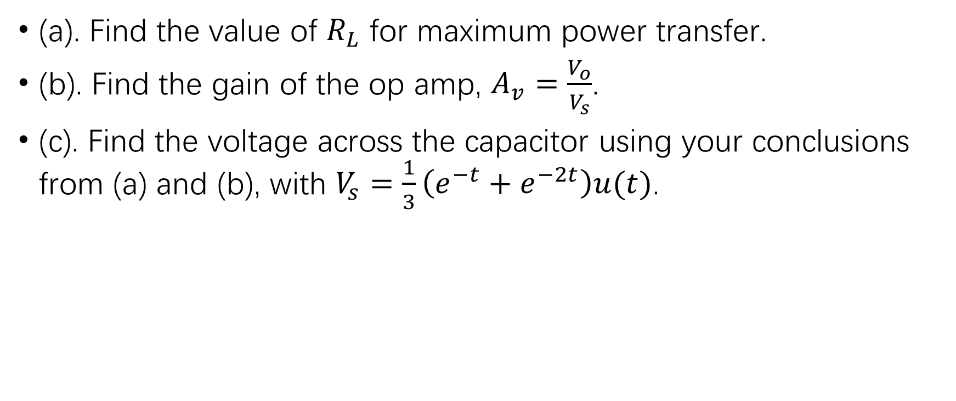
Exercise
(a). Find the value of $R_{L}$ for maximum power transfer.
(b). Find the gain of the op amp, $A_{v}=\frac{V_{o}}{V_{s}}$.
(c). Find the voltage across the capacitor using your conclusions from (a) and (b), with $V_{s}=\frac{1}{3}\left(e^{−t}+e^{−2t}\right)u(t)$.

Slide 17
Duality
Resistance
Inductance
Voltage
Node
Series
Open (switch open)
KVL
Thevenin
Clockwise mesh current
Conductance
Capacitance
Current
Mesh
Parallel
Short (switch closed)
KCL
Norton
Positive voltage from ground to nonreference node

Slide 18
Duality
Place a node at the center of each mesh and add one extra node outside the circuit as the ground node.
Draw lines across the components to connect the nodes and replace them with their duals.
Values of resistance are changed into reciprocals.

